Slide 1



Warehouse Management System
By TechBoys
1

Slide 2
Introduction
Why WMS?: Efficient warehouse management is crucial for smooth retail operations.
What is WMS?: A user-friendly platform for managing warehouses shared by shopkeepers under admin supervision.
Goals: Streamline operations, enhance security, and offer tailored features for admins and shopkeepers.
2

Slide 3



Meet Our Teams
TechBoys
Abhijeet Cherungottil
Sumanth Kumar Katapally
Sagar Shankaran
Member
Head
Member
3

Slide 4

INTRODUCTION
Efficient Warehouse Management:
Designed to streamline operations in a shared warehouse environment.
Admin Features:
Secure login, shopkeeper management, and full inventory control (add, edit, delete items).
Shopkeeper Features:
Search inventory, request items, save favorites, and track borrowing history.
User-Friendly Design:
Intuitive interface, tabular reports, and clear navigation for easy use.
Enhanced Security:
Password encryption and safeguards against errors like duplicate entries or exceeding limits.
4

Slide 5
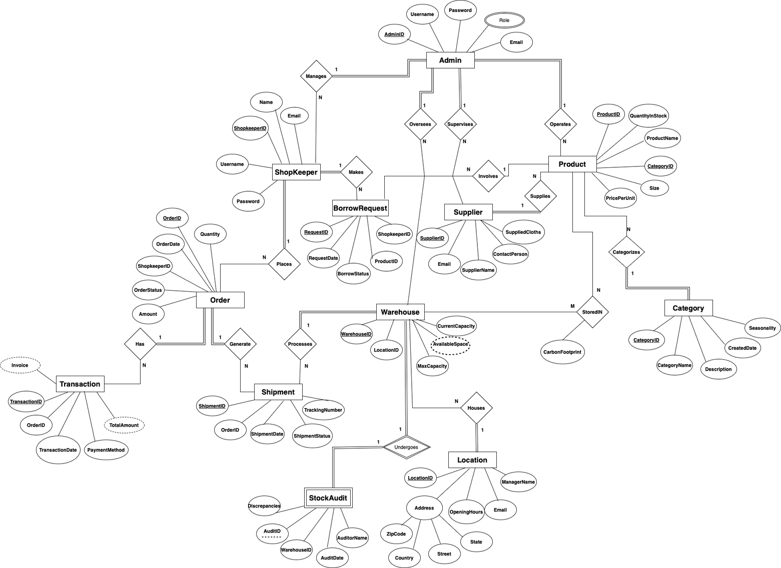
Entity Relationship Models
Combined Conceptal Model
5

Slide 6
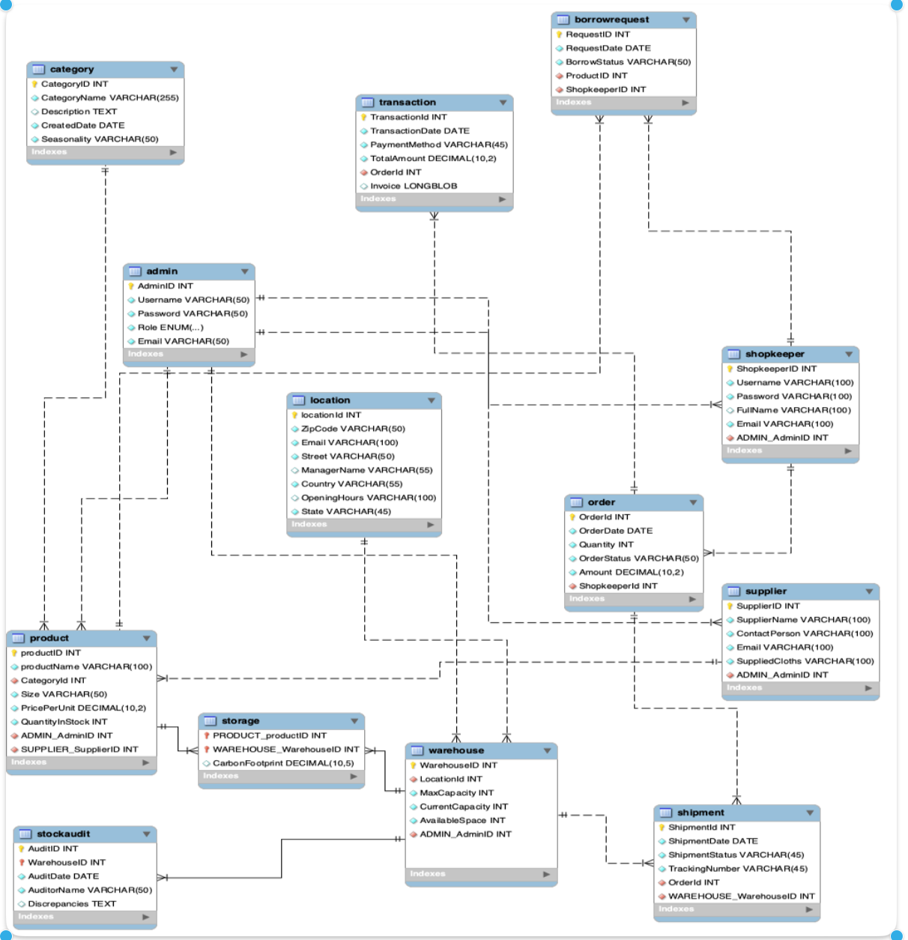
Enhanced Entity Relationship Model
6

Slide 7
CREATE Warehouse Management System DBMS Project
DATABASE:
DATABASE DEVELOPMENT
CREATE DATABASE IF NOT EXISTS `Warehouse_Management_System_DBMS_Project`;
USE `Warehouse_Management_System_DBMS_Project`;
Also created table for all entity that was discussed before accord to EER Diagram
7

Slide 8
Loading the data in SQL
Bulk multiple insert
Load by CSV
1
2
What We Do
What We Do
LOAD DATA INFILE 'admin.csv' INTO TABLE ADMIN FIELDS TERMINATED BY ',' LINES TERMINATED BY '\n';
Also 'shopkeeper.csv' ,category.csv and supplier.csv
Add data using Multiple value for inserting date.
Inserted other entity using this method
8

Slide 9
Optimizing the data in SQL
INSERTION OPTIMIZATION
INDEX OPTIMIZATION
1
2
What We Do
What We Do
Used bulk INSERT statements instead of INSERTING records individually
Execution time to insert each row with a single insert statement would be 5*0.031= 0.155 secs approximately, whereas to execute the bulk statement to insert values, it only took 0.016 secs as shown above.
To improve the performance of select operations is to create indexes on one or more of the columns
Before indexing selection took 0.107 sec and after it only took 0.0195 sec.
9

Slide 10
NORMALIZATION the data in SQL
●First Normal Form:
○ Every table has a primary key
○Every value is single-valued
●Second Normal Form:
○Meets the criteria of the 1NF
○Any data that is not a key relies on the PK.
●Third Normal Form:
○Meets the criteria of 1NF and 2NF
○There are no transitive dependencies between non-key attributes
10

Slide 11

Thank you!
11

Slide 12

DEMO
12

